Slide 1
Microsoft Dynamics AX 2012 Administration Workshop Chapter 8: Manage AOS Load Balancing
Presenter Name
Presenter Title
Presenter Company

Slide 2
Conditions and Terms of Use
Microsoft Confidential
This training package is proprietary and confidential, and is intended only for uses described in the training materials. Content and software is provided to you under a Non-Disclosure Agreement and cannot be distributed. Copying or disclosing all or any portion of the content and/or software included in such packages is strictly prohibited.
The contents of this package are for informational and training purposes only and are provided "as is" without warranty of any kind, whether express or implied, including but not limited to the implied warranties of merchantability, fitness for a particular purpose, and non-infringement.
Training package content, including URLs and other Internet Web site references, is subject to change without notice. Because Microsoft must respond to changing market conditions, the content should not be interpreted to be a commitment on the part of Microsoft, and Microsoft cannot guarantee the accuracy of any information presented after the date of publication. Unless otherwise noted, the companies, organizations, products, domain names, e-mail addresses, logos, people, places, and events depicted herein are fictitious, and no association with any real company, organization, product, domain name, e-mail address, logo, person, place, or event is intended or should be inferred.
Copyright and Trademarks
© 2013 Microsoft Corporation. All rights reserved.
Microsoft may have patents, patent applications, trademarks, copyrights, or other intellectual property rights covering subject matter in this document. Except as expressly provided in written license agreement from Microsoft, the furnishing of this document does not give you any license to these patents, trademarks, copyrights, or other intellectual property.
Complying with all applicable copyright laws is the responsibility of the user. Without limiting the rights under copyright, no part of this document may be reproduced, stored in or introduced into a retrieval system, or transmitted in any form or by any means (electronic, mechanical, photocopying, recording, or otherwise), or for any purpose, without the express written permission of Microsoft Corporation.
For more information, see Use of Microsoft Copyrighted Content at http://www.microsoft.com/about/legal/permissions/
Microsoft®, Active Directory®, Excel®, Microsoft Dynamics®, and SQL Server® are either registered trademarks or trademarks of Microsoft Corporation in the United States and/or other countries. Other Microsoft products mentioned herein may be either registered trademarks or trademarks of Microsoft Corporation in the United States and/or other countries. All other trademarks are property of their respective owners.

Slide 3
Students: How to View this Presentation
Switch to Notes Page view
Click View on the ribbon and select Notes Page
Use page up or page down to navigate
Zoom in or out as needed
Most slides will have supporting text that you can view now or after the delivery
Add notes to your copy of the presentation if you want to take the presentation files home with you.

Slide 4
Objective
After completing this chapter, you will be able to:
Provide an overview of load balancing and how it works
Set up a cluster with a load balancer
Set up a cluster without a load balancer

Slide 5
Introduction
Use load balancing to distribute the user load among multiple Application Object Server (AOS) instances.
AOS load balancing in Microsoft Dynamics AX has the following benefits:
Less downtime: If one AOS instance fails, new sessions can be automatically routed to different AOS instances
Easier maintenance: Take an AOS instance offline for maintenance while other AOS instances handle the load
Greater scalability: AOS instances can be added as needed

Slide 6
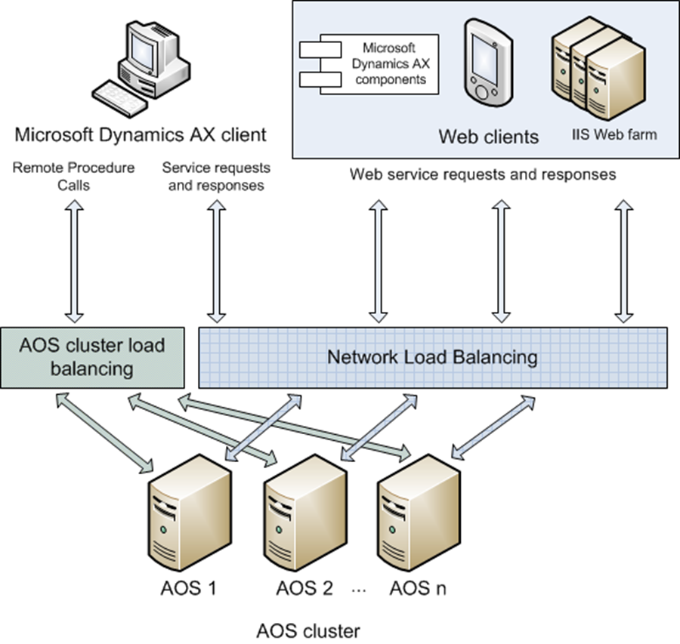
Load Balancing Types
Two types of load balancing can be set up:
Native AOS load balancing for RPC traffic.
Network Load Balancing (NLB) for WCF services traffic.
Notes:
Clients communicate with AOS instances in two different ways:
Remote Procedure Calls (RPCs), which are hosted on TCP port 2712, by default.
Windows Communication Foundation (WCF) services, which are hosted on TCP ports 8101 (WSDL) and 8201 (services endpoint), by default.
Below is a quick reference guide for which clients use RPC and which clients use services:
Microsoft Dynamics AX client > RPC and WCF services
Enterprise Portal > RPC and WCF services
IIS (Web services) > WCF services
IIS (Help server) > WCF services
Office Add-ins (Word, Excel) > WCF services
Report Server > WCF services

Slide 7
Native Load Balancing Cluster
Used to distribute user (RPC) connections across multiple AOS instances
You can create multiple clusters, for example:
Cluster 1: Contains servers A and B. Used for Enterprise Portal users.
Cluster 2: Contains servers C and D. Used for sales order entry.
Cluster 3: Contains servers E and F. Used for integrations and batch processing.
Notes:
Load Balancing Cluster
To distribute the user and transaction load among multiple Application Object Server (AOS) instances, you must add the instances to a load balancing group, or cluster.
You can create multiple clusters so that users performing similar functions are always connected to the same set of servers. For example, you might set up the following clusters:
Cluster 1: Contains servers A and B. Used for Enterprise Portal users.
Cluster 2: Contains servers C and D. Used for sales order entry.
Cluster 3: Contains servers E and F. Used for integrations and batch processing.

Slide 8
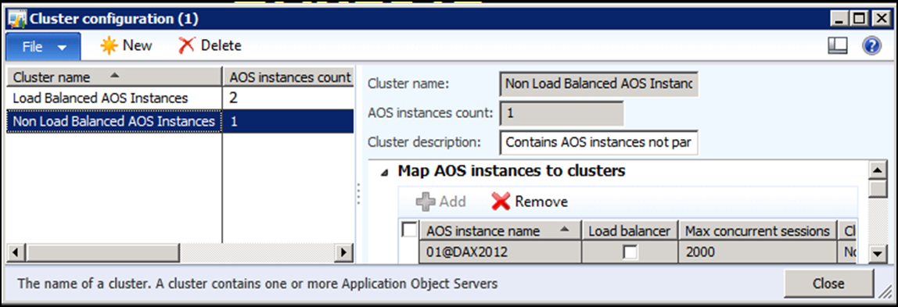
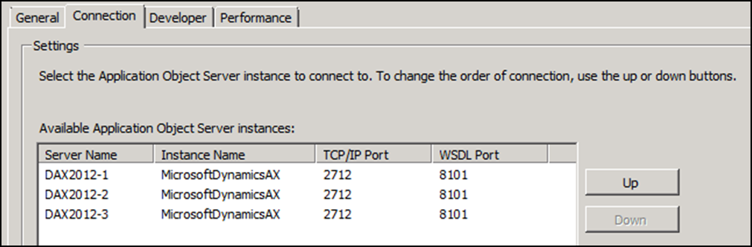
Setup for High Availability
AOS cluster configuration (at least 2 instances in a cluster)
AX client configuration (at least 2 AOS instances in config)
Note: This load balancing config only applies to RPC traffic. It does not apply to services.
Notes:
For AOS high availability, it is recommended to have N + 1 AOS’s where N is the number of AOS’s required to handle the maximum load. The additional server allows for one server to be offline at a time for maintenance.
Once the AOS instances are grouped appropriately, the next step is to define the client configurations for high availability. For consistency and ease of administration, it is considered a best practice to use a shared configuration file. The shared configuration file should list all servers that are part of the AOS cluster. If a client connection is broken due to an AOS failure, all that is required in order to reconnect to one of the remaining AOS’s is a simple restart of the client application.

Slide 9
Native Load Balancing Cluster Types
There are two types of native load balancing clusters:
A cluster with a dedicated load balancer
A cluster without a dedicated load balancer

Slide 10
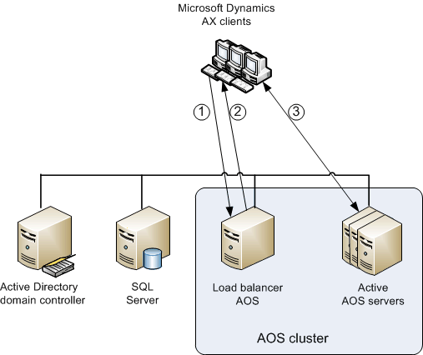
Cluster with a Dedicated Load Balancer
Notes:
If you set up a cluster with a load balancer, the load balancer AOS instance is dedicated to distributing the user load. The load balancer AOS instance does not accept client connections. A cluster that contains a load balancer AOS instance must also contain at least one AOS instance that is not a load balancer.
In this configuration, you must set client configurations to connect to the load balancer AOS instance.
How it works:
When a client starts, it connects to the load balancer AOS instance.
The load balancer AOS instance returns a list of active AOS servers in the cluster, sorted based on workload.
The client tries connecting to the first AOS instance in the list.
If that connection fails, the client attempts to connect to the second AOS instance in the list, and so on.
Note: If an AOS instance is set up as a load balancer, it cannot be used as a batch server.
Best Practice: If using a cluster with the load balancer, it is still recommended to specify the load balancer first, and then each additional AOS instance in the client configuration in case your load balancer fails.

Slide 11
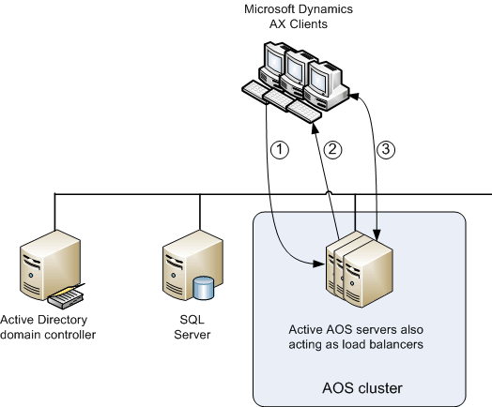
Cluster with no Dedicated Load Balancer
Notes:
If you set up a cluster without a load balancer, each AOS instance acts as both a load balancer and an active AOS instance that accepts client connections.
How it works:
When a client starts, it sends a request to the first server that is listed in the client configuration.
That server returns the list of the active AOS’s in the cluster, sorted based on workload.
The client tries connecting to the first AOS instance in the list.
If that connection fails, the client attempts to connect to the second AOS instance in the list, and so on.
Best Practice: It is recommended to specify each AOS instance from the cluster in the client configuration.

Slide 12
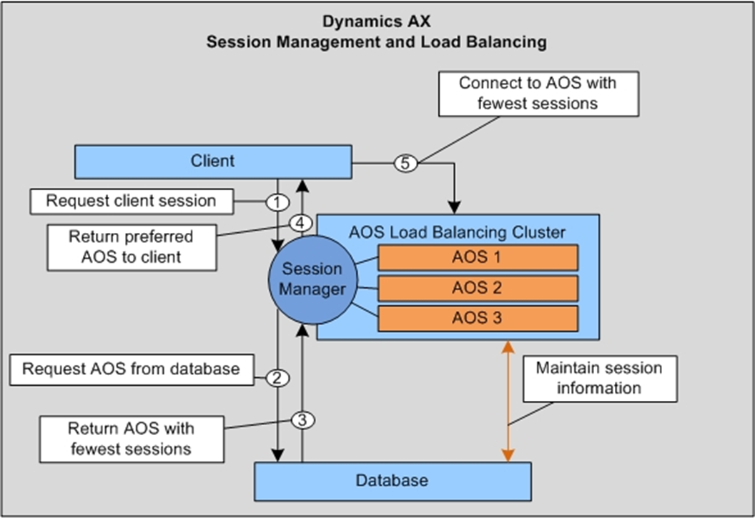
Native Load Balancing Cluster Steps
Load balancing for RPC client connections includes:
AX client
EP
Note: The AX client and EP both use a mix of RPC and WCF services
Microsoft Dynamics AX
Session Management and Load Balancing
Notes:
AOS session management and High Availability load balancing process.
A client requests a new session from the first AOS listed in the client configuration.
The AOS that receives the request queries for cluster/session information stored in the database.
The database returns the AOS name in the cluster with the fewest sessions.
The AOS processing the client request returns this information to the client.
The client establishes a connection with the AOS in the cluster that has the fewest sessions.

Slide 13
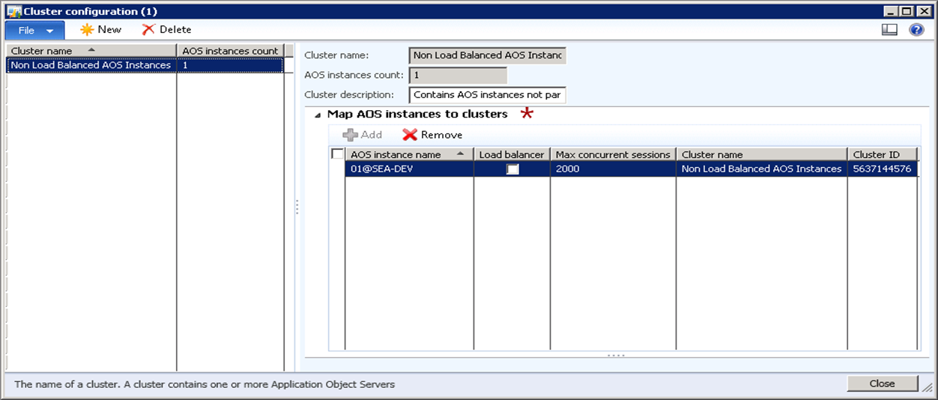
Setup Cluster with Load Balancer
Scenario:
You want to load balance AOS instances using a dedicated load balancer.
Procedure:
System administration > Setup > System > Cluster configuration
Notes:
Open Microsoft Dynamics AX Server Configuration Utility and set all three AOS instances to start on the following ports:
$01 - 2712
$02 - 2713
$03 – 2714
Start up all three AOS instances on your machine.
Open System administration > Setup > System > Cluster configuration.
Create a new cluster and name it Load Balanced AOS Instances.
Select the Map AOS instances to clusters tab.
For the $03 AOS instance, select the Load Balancer check box.
In the Cluster name field drop-down, select the Load Balanced AOS Instances for all three of the AOS instances, and then press CTRL+S to save changes.
Modify your Microsoft Dynamics AX Configuration to only have the $03 AOS instances in the Connection tab.
Launch three or four different Microsoft Dynamics AX sessions.
Go to System Administration > Online uses and view the AOS instances that each one of the sessions logged into.
Why is it only load balancing for 2712 and 2713?
Now remove $03 from the Microsoft Dynamics AX Configuration.
Launch three or four different Microsoft Dynamics AX sessions.
Go to System Administration > Online uses and view the AOS instances that each one of the sessions logged into.
Why is it still load balancing for 2712 and 2713?
Note: If an AOS instance is set up as a load balancer, it cannot be used as a batch server.
Note: The benefit of the load balancer is that you can then add and remove other AOS instances from the cluster without needing to update client configurations.

Slide 14
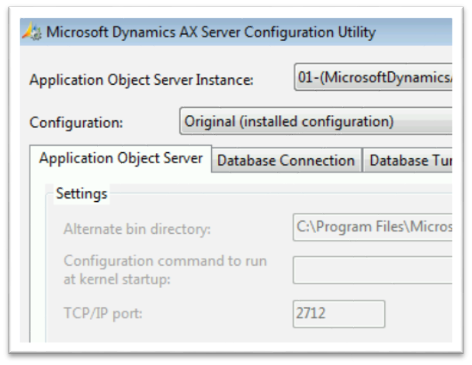

Procedure: Start all AOS Instances
Open Microsoft Dynamics AX Server Configuration Utility and set all three AOS instances to start on the following ports:
$01 - 2712
$02 - 2713
$03 - 2714

Slide 15
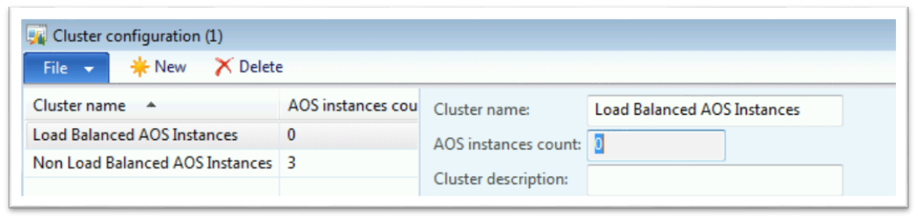
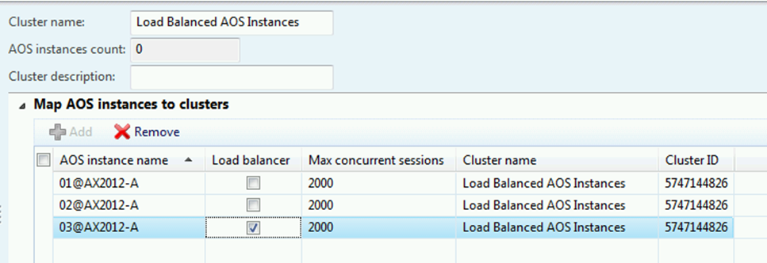
Procedure: Create a Load Balancing Cluster w/ Load Balancer
Create a new cluster and name it Load Balanced AOS Instances
Select the Map AOS instances to clusters tab.
For the $03 AOS instance, select the Load Balancer check box.

Slide 16
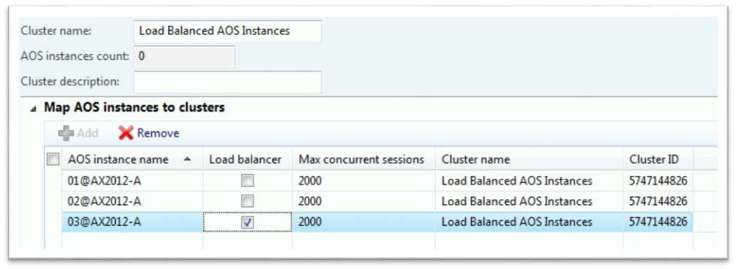
Procedure: Create a Load Balancing Cluster w/ Load Balancer
In the Cluster name field drop down, select the Load Balanced AOS Instances for all three of the AOS instances.
Press CTRL+S to save changes.

Slide 17
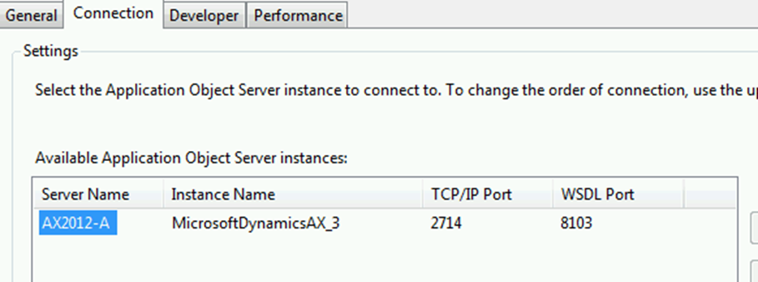
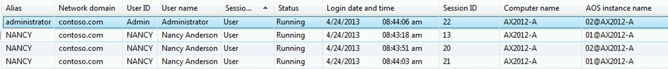
Procedure: Create a Load Balancing Cluster w/ Load Balancer
Modify your Microsoft Dynamics AX Configuration to only have the $03 AOS instances in the Connection tab.
Launch three or four different Microsoft Dynamics AX sessions as Jenny and Administrator.
Go to System Administration > Online uses and view the AOS instances that each one of the sessions logged into.

Slide 18
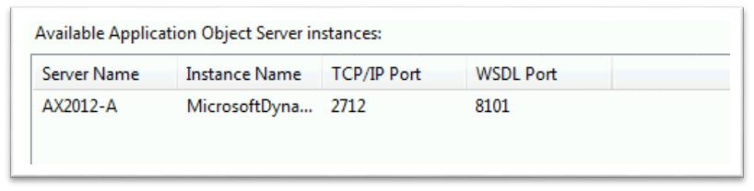
Procedure: Create a Load Balancing Cluster w/ Load Balancer
Why is it only load balancing for 2712 and 2713?
Now remove $03 from the Microsoft Dynamics AX Configuration and add only $01.
Launch three or four different Microsoft Dynamics AX sessions.
Go to System Administration >Online uses and view the AOS instances that each one of the sessions logged into.
Why is it still load balancing for 2712 and 2713?

Slide 19
Set up Cluster Without a Load Balancer
Scenario:
You want to load balance AOS instances without using a dedicated load balancer.
Procedure:
System administration > Setup > System > Cluster configuration
Notes:
In this procedure, you will set up a cluster without a load balancer.
Open System administration > Setup > System > Cluster configuration.
In the Cluster configuration form, click the Map AOS instances to clusters tab.
Clear the Load Balancer check box on all of AOS instances.
In the Cluster name field drop-down, select the Load Balanced AOS instances for all three of the AOS instances, and then press CTRL+S to save changes.
Open the Microsoft Dynamics AX Configuration Utility and add all three AOS’s in the Connection tab:
$01 - 2712
$02 - 2713
$03 - 2714
Launch three or four different Microsoft Dynamics AX sessions.
Go to System Administration > Online uses and view the AOS instances that each one of the sessions logged into.
Why is Jenny going to a different AOS even though her Configuration file is saved with port 2712?
Now remove 2712 and 2713 out of the Microsoft Dynamics AX Configuration Utility.
Launch three or four different Microsoft Dynamics AX sessions.
Go to System Administration > Online uses and view the AOS instances that each one of the sessions logged into.
Why is it still load balancing?
Note: The benefit of the load balancer is that you can then add and remove other AOS instances from the cluster without needing to update client configurations.
Note: If an AOS instance is set up as a load balancer, it cannot be used as a batch server.

Slide 20
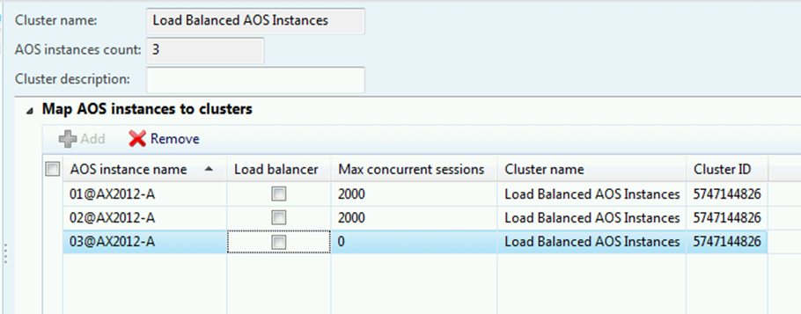
Procedure: Create a load balancing cluster with no load balancer
Open System administration > Setup > System > Cluster configuration.
In the Cluster configuration form, click the Map AOS instances to clusters tab.
Clear the Load Balancer check box on all of AOS instances.
In the Cluster name field drop-down, select the Load Balanced AOS Instances for all three of the AOS instances.
Press CTRL+S to save changes.

Slide 21
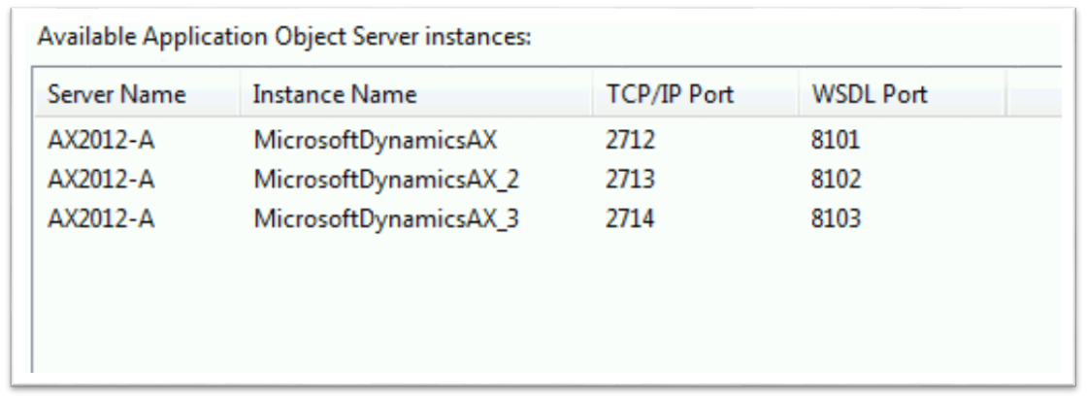
Procedure: Create a load balancing cluster with no load balancer
Open the Microsoft Dynamics AX Configuration Utility and add all three AOS’s in the Connection tab:
$01 - 2712
$02 - 2713
$03 - 2714

Slide 22
Procedure: Create a load balancing cluster with no load balancer
Launch three or four different Microsoft Dynamics AX sessions.
Go to System Administration > Online uses and view the AOS instances that each one of the sessions logged into.
Why are the sessions going to a different AOS even though the Configuration file is saved with port 2712?
Now remove 2712 and 2713 out of the Microsoft Dynamics AX Configuration Utility.
Launch three or four different Microsoft Dynamics AX sessions.
Go to System Administration > Online uses and view the AOS instances that each one of the sessions logged into.
Why is it still load balancing?

Slide 23
Removing from Cluster
Procedure: Remove an AOS from load balancing:
Determine whether the AOS instance is configured as a load balancer. If the server is a load balancer, and no other load balancer is available, client connections may fail when you take the server offline.
Determine whether the AOS instance is a batch server. If the server is a batch server, and no other batch server is available, batch processes do not run. Verify that other servers in the environment are available for batch processing, or configure a different server for batch processing.
Notes:
Note: In this configuration, client configurations must contain connection information for multiple AOS instances. If you need to remove an AOS instance from the cluster, you must update the client configurations that refer to that instance.

Slide 24
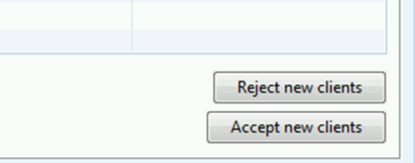
Removing from Cluster
Drain all users from the AOS instance that you want to remove from load balancing.
Connect to the AOS instance that you want to remove from load balancing. You can either change your client configuration so that it points to the AOS instance, or use the following command-line parameters: -aos2= Server_name and -loadbalance=0.
Click System administration > Common > Users > Online users.
Verify that you are connected to the correct AOS instance and the AOS instance is not servicing any other clients.

Slide 25
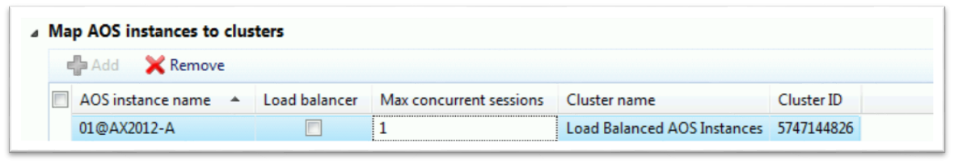
Removing from Cluster
Click System administration > Setup > System > Cluster configuration.
In the Max concurrent sessions field, enter 1.
Verify that the Load balancer option is not selected.
In the Map AOS instances to clusters section, select the AOS instance that you want to remove, and then click Cluster Name and change it to Non Load Balanced AOS Instance. The AOS instance is now a stand-alone server. To delete the AOS instance from the environment, you must uninstall it by using Setup.

Slide 26
Setup for High Availability (WCF Services)
Use Network Load Balancing (NLB) to load balance services traffic.
There are changes that need to be made to clients to make the load balancing work properly.
Client configuration utility
Registry
Web.config
Reference guide for setup: http://msdn.microsoft.com/en-us/library/hh397322.aspx

Slide 27
Chapter Review
True or False? It is possible to configure multiple load balancing clusters?
( ) True
( ) False
True or False? An AOS that is a dedicated load balancer can also be designated as the batch server.
( ) True
( ) False

Slide 28
Chapter Review (Answers)
True or False? It is possible to configure multiple load balancing clusters?
(x) True
( ) False
True or False? An AOS that is a dedicated load balancer can also be designated as the batch server.
( ) True
(x) False

Slide 29
Chapter Summary
In this chapter, we discussed:
The different types of load balancing
How load balancing works
How to set up a cluster
How to remove an instance from a cluster

